Slide 1
Programmable Pipelines
Matt Evett
Dept. of Computer Science
Eastern Michigan University

Slide 2
Objectives
Introduce programmable pipelines
  Vertex shaders
  Fragment shaders
Introduce shading languages
  Needed to describe shaders
  RenderMan
Angel: Interactive Computer Graphics 5E © Addison-Wesley 2009

Slide 3
Introduction
Recent major advance in real time graphics is programmable pipeline
  First introduced by NVIDIA GForce 3
  Supported by high-end commodity cards
    NVIDIA, ATI, 3D Labs
  Software Support
    Direct X 8 , 9, 10
    OpenGL Extensions
    OpenGL Shading Language (GLSL)
    Cg
Angel: Interactive Computer Graphics 5E © Addison-Wesley 2009

Slide 4
Background
Two components
  Vertex programs (shaders)
  Fragment programs (shaders)
Requires detailed understanding of two seemingly contradictory apporachs
  OpenGL pipeline
    Real time
  RenderMan ideas
    offline
Angel: Interactive Computer Graphics 5E © Addison-Wesley 2009

Slide 5
Black Box View
vertices
vertices
fragments
fragments
CPU
Geometry
Processor
Rasterizer
Fragment
Processor
Frame
Buffer
Angel: Interactive Computer Graphics 5E © Addison-Wesley 2009

Slide 6
Geometric Calculations
Geometric data: set of vertices + type
  Can come from program, evaluator, display list
  type: point, line, polygon
  Vertex data can be
    (x,y,z,w) coordinates of a vertex (glVertex)
    Normal vector
    Texture Coordinates
    RGBA color
    Other data: color indices, edge flags
    Additional user-defined data in GLSL
Angel: Interactive Computer Graphics 5E © Addison-Wesley 2009

Slide 7
Per-Vertex Operations
Vertex locations are transformed by the model-view matrix into eye coordinates
Normals must be transformed with the inverse transpose of the model-view matrix so that v·n=v’ ·n’ in both spaces
  Assumes there is no scaling
  May have to use autonormalization
Textures coordinates are generated if autotexture enabled and the texture matrix is applied
Angel: Interactive Computer Graphics 5E © Addison-Wesley 2009

Slide 8
Lighting Calculations
Consider a per-vertex basis Phong model
Phong model requires computation of r and v at every vertex
I =k_{d} I_{d} l · n + k_{s} I_{s} (v · r )^{α} + k_{a} I_{a}
Angel: Interactive Computer Graphics 5E © Addison-Wesley 2009

Slide 9
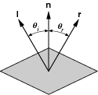
Calculating the Reflection Term
angle of incidence = angle of reflection
cos θ_{i} = cos θ_{r} or r·n = l·n
r, n, and l are coplanar
r = αl + βn
normalize
1 = r·r = n·n = l·l
solving: r = 2(l · n)n-l
Angel: Interactive Computer Graphics 5E © Addison-Wesley 2009

Slide 10
OpenGL Lighting
Modified Phong model
  Halfway vector
  Global ambient term
Specified in standard
Supported by hardware
Angel: Interactive Computer Graphics 5E © Addison-Wesley 2009

Slide 11
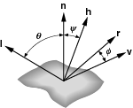
Halfway Vector
Blinn proposed replacing v·r by n·h where
h = (l+v)/|l + v|
(l+v)/2 is halfway between l and v
If n, l, and v are coplanar:
ψ = φ/2
Must then adjust exponent
so that (n·h)^{e’} ≈ (r.v)^{e}
Angel: Interactive Computer Graphics 5E © Addison-Wesley 2009

Slide 12
Primitive Assembly
Vertices are next assembled into objects
  Polygons
  Line Segements
  Points
Transformation by projection matrix
Clipping
  Against user defined planes
  View volume, x=±w, y=±w, z=±w
  Polygon clipping can create new vertices
Perspective Division
Viewport mapping
Angel: Interactive Computer Graphics 5E © Addison-Wesley 2009

Slide 13
Rasterization
Geometric entities are rasterized into fragments
Each fragment corresponds to a point on an integer grid: a displayed pixel
Hence each fragment is a potential pixel
Each fragment has
  A color
  Possibly a depth value
  Texture coordinates
Angel: Interactive Computer Graphics 5E © Addison-Wesley 2009

Slide 14
Fragment Operations
Texture generation
Fog
Antialiasing
Scissoring
Alpha test
Blending
Dithering
Logical Operation
Masking
Angel: Interactive Computer Graphics 5E © Addison-Wesley 2009

Slide 15
Vertex Processor
Takes in vertices
  Position attribute
  Possibly color
  OpenGL state
Produces
  Position in clip coordinates
  Vertex color
Angel: Interactive Computer Graphics 5E © Addison-Wesley 2009

Slide 16
Fragment Processor
Takes in output of rasterizer (fragments)
  Vertex values have been interpolated over primitive by rasterizer
Outputs a fragment
  Color
  Texture
Fragments still go through fragment tests
  Hidden-surface removal
  alpha
Angel: Interactive Computer Graphics 5E © Addison-Wesley 2009

Slide 17
Programmable Shaders
Replace fixed function vertex and fragment processing by programmable processors called shaders
Can replace either or both
If we use a programmable shader we must do all required functions of the fixed function processor
Angel: Interactive Computer Graphics 5E © Addison-Wesley 2009

Slide 18
Development
RenderMan Shading Language
  Offline rendering
Hardware Shading Languages
  UNC, Stanford
  NVIDIA
  OpenGL Vertex Program Extension
  OpenGL Shading Language
  Cg
    OpenGL
    Microsoft HLSL
Angel: Interactive Computer Graphics 5E © Addison-Wesley 2009

Slide 19
RenderMan
Developed by Pixar
  S. Upstill, The RenderMan Companion, Addison-Wesley, 1989.
Model
interface file (RIB)
Modeler
Renderer
Angel: Interactive Computer Graphics 5E © Addison-Wesley 2009

Slide 20
Modeling vs Rendering
Modeler outputs geometric model plus information for the renderer
  Specifications of camera
  Materials
  Lights
May have different kinds of renderers
  Ray tracer
  Radiosity
How do we specify a shader?
Angel: Interactive Computer Graphics 5E © Addison-Wesley 2009

Slide 21
Shading Trees
Shaders such as the Phong model can be written as algebraic expressions
But expressions can be described by trees
Need now operators such as dot and cross products and new data types such as matrices and vectors
Environmental variables are part of state
I =k_{d} I_{d} l · n + k_{s} I_{s} (v · r )^{s} + k_{a} I_{a}
Angel: Interactive Computer Graphics 5E © Addison-Wesley 2009

Slide 22
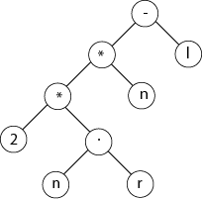
Reflection Vector
Angel: Interactive Computer Graphics 5E © Addison-Wesley 2009

Slide 23
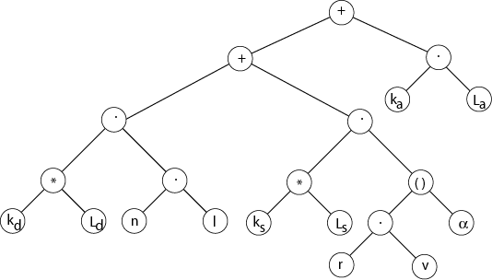
Phong Model
Angel: Interactive Computer Graphics 5E © Addison-Wesley 2009

